Slide 1

Data as a Service
Powered by

Slide 2



Gujarat University
Department of Computer Science
MCA
Semester 6 Project
Rohit Moga : MCA-VI : 60017
Internal Guide : Dr. Hardik Joshi
Vivek Barbhaya : MCA-VI : 60011
External Guide : Jay Trivedi and Vikas Surani

Slide 3
Internship Details
Company Name : GlobalVox Inc.
Mentor Name : Jay Trivedi
Project Definition : Data and API as a Service
Project URL : http://150.136.150.122:8080/DAAS

Slide 4
What is Daas / Aaas ?
E-commerce platform
Selling of Watchlist Screenings
Selling of International Trade Data
B2B and B2C Model

Slide 5
Technology Architecture
Front End
Back End
Other Tools
HTML, CSS, JavaScript
MySQL (Workbench)
Microsoft Teams
Thymeleaf
Java SpringBoot (IntellijIDEA)
ZOHO
Ajax, jQuery
Hibernate
Jenkins

Slide 6
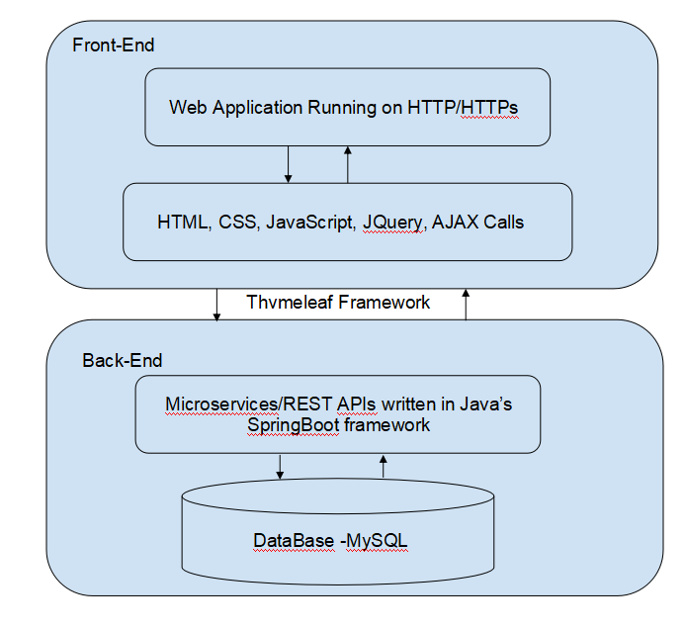
System Architecture

Slide 7
Problem Statement
Hard to identify the genuineness of a customer
Very difficult to track record of International Trade Data
No system was available to smooth the International Trade

Slide 8
Proposed Solution
Our special team monitors the black listings of all countries around the globe
Provides the data and API to authenticate the customer / person / organization
Covers the International trade data ranging from customs to list of ports to product classification
Provides reach features in Watchlist Screening with categories such as Financial Frauds, International Terrorists, Interpole Bans etc.

Slide 9
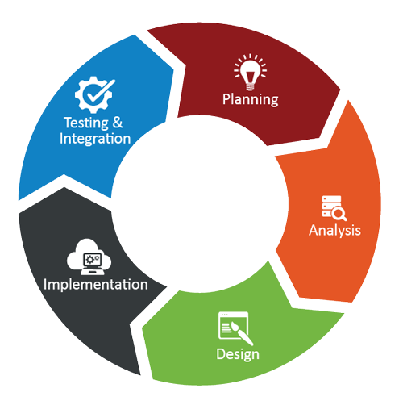

Software Building Approach
Agile Software Development Life Cycle

Slide 10
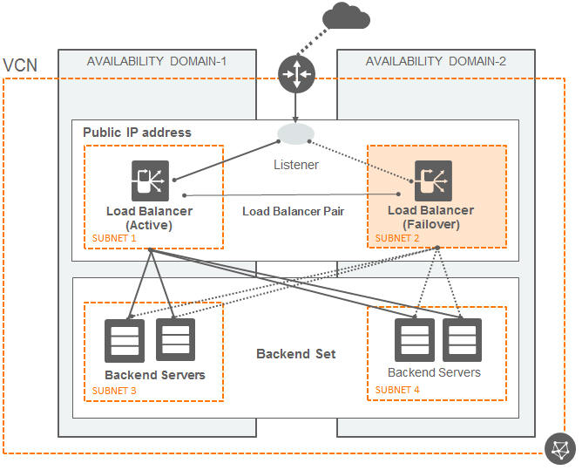
Deployment Architecture

Slide 11





System Process Flow
Shop for
Customs Data
Web Services
Order Placed
Fired a mail
Download Invoice
Download Data file
Customer
Login and
Registration
My Account
Online
Payment
via Stripe
My Orders
Subscription Details
View / Edit Profile
Change Password

Slide 12
Use Case Diagram

Slide 13
Activity Diagram

Slide 14
Entity Relationship
Diagram

Slide 15
Sequence Diagram

Slide 16
Screen Shots

Slide 17
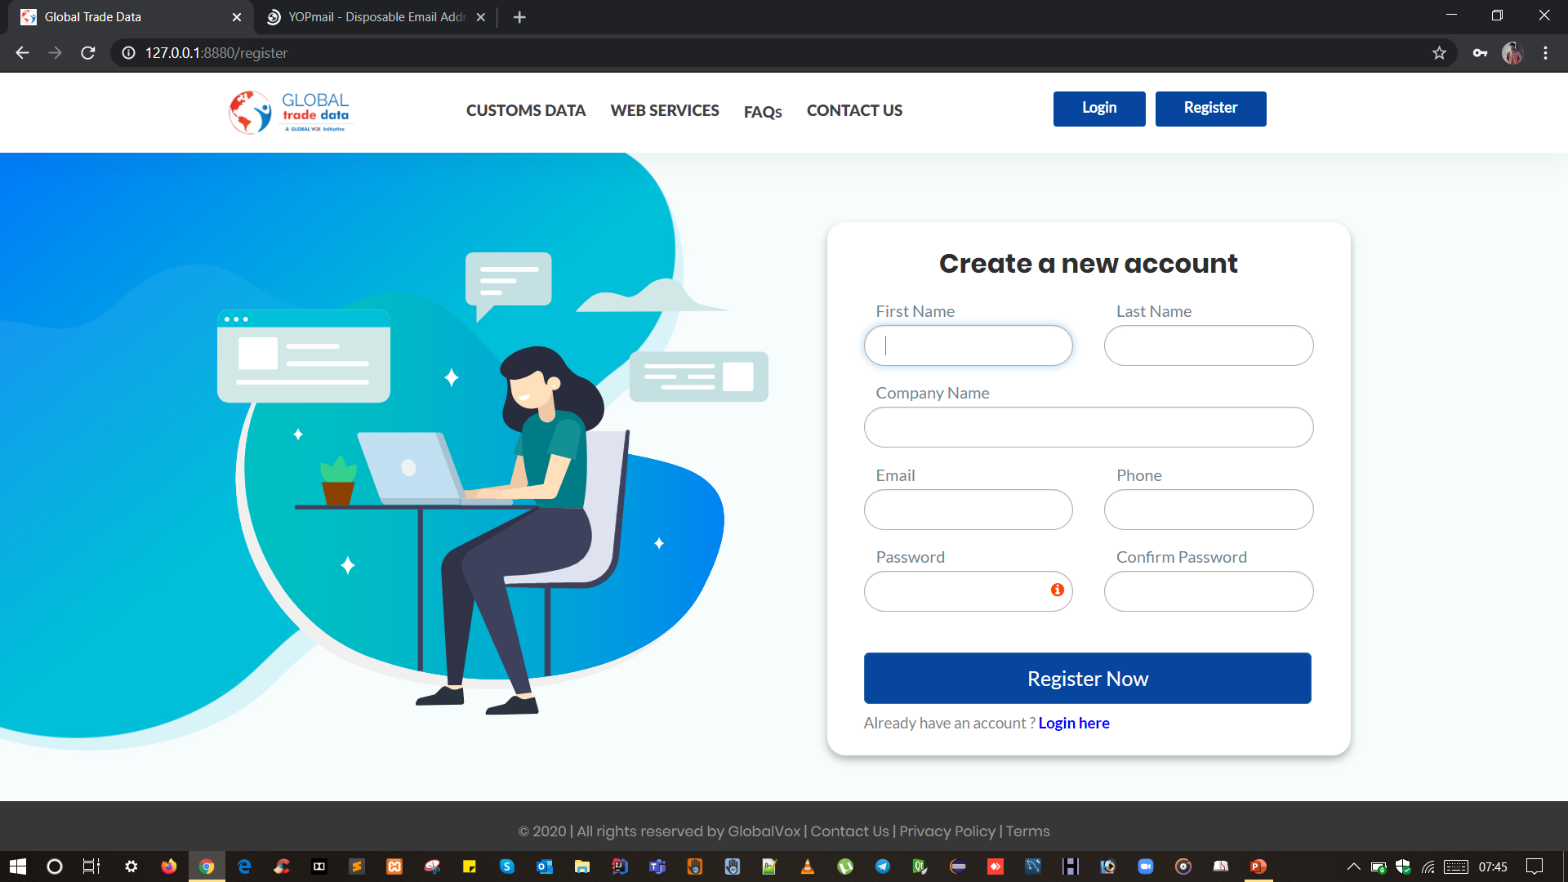

Slide 18


Slide 19
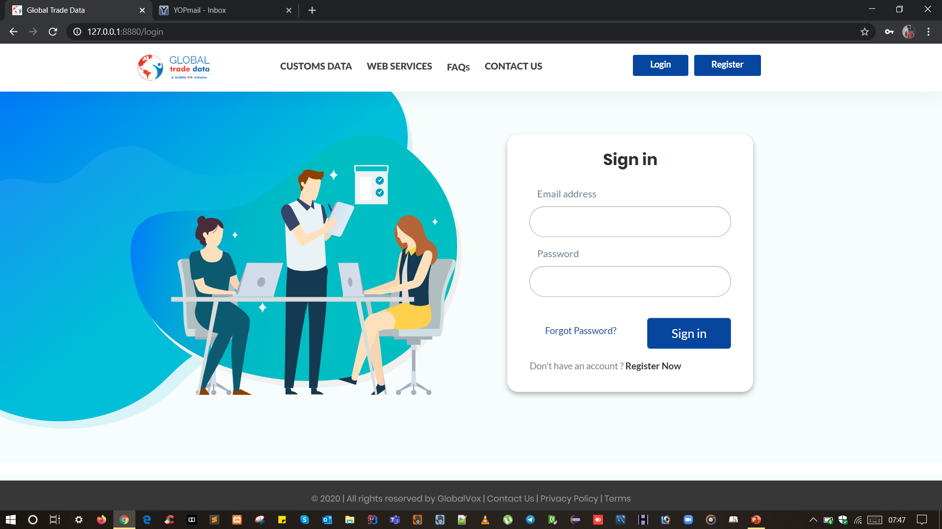

Slide 20


Slide 21
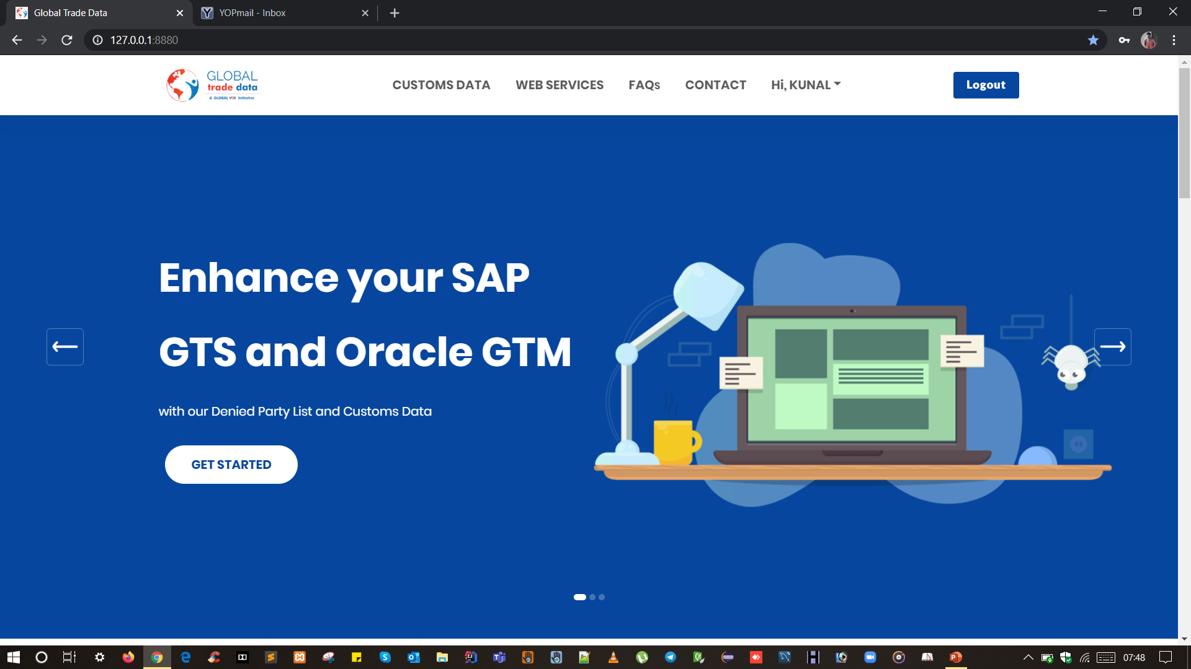

Slide 22
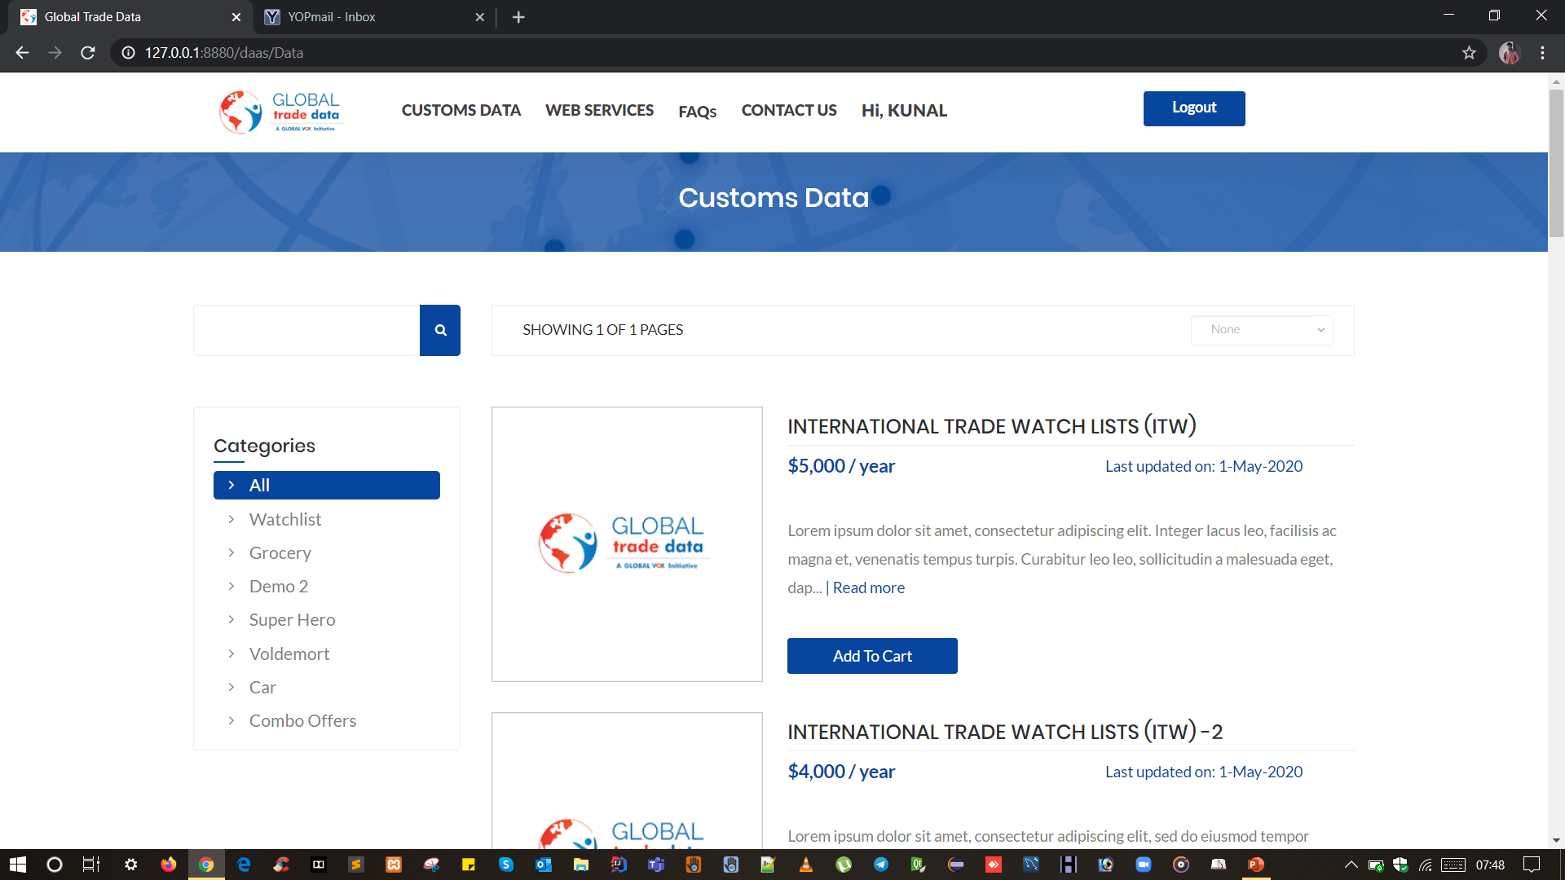

Slide 23
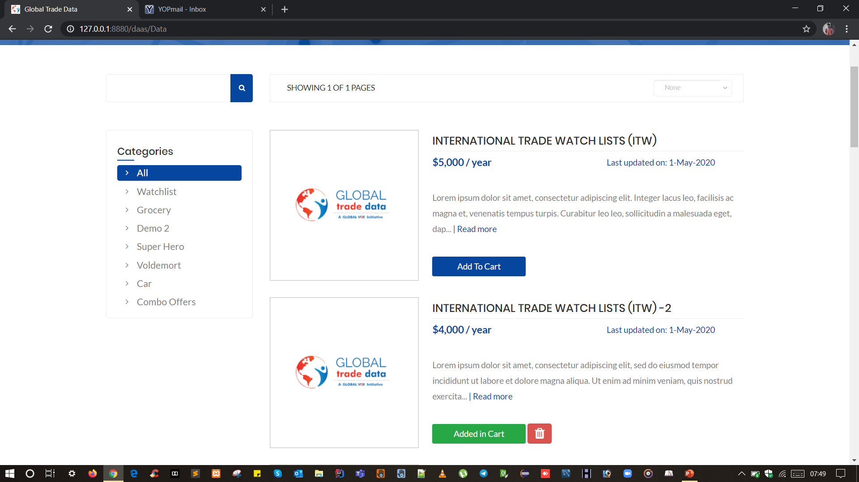

Slide 24
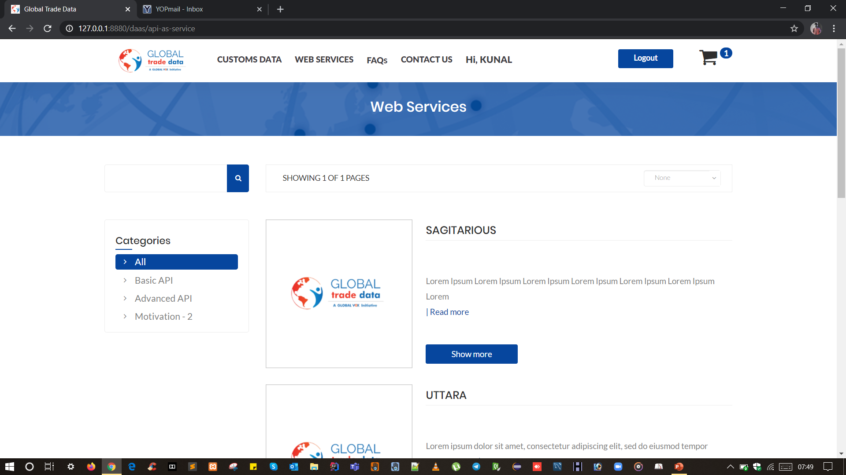

Slide 25
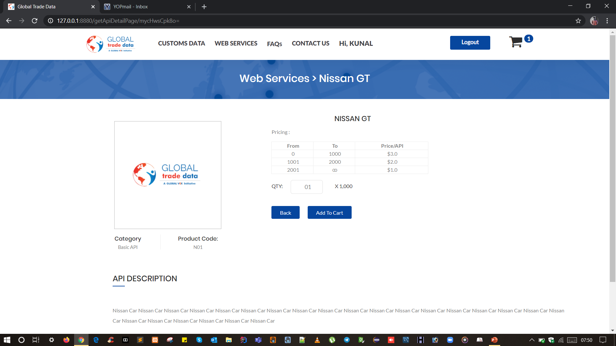

Slide 26
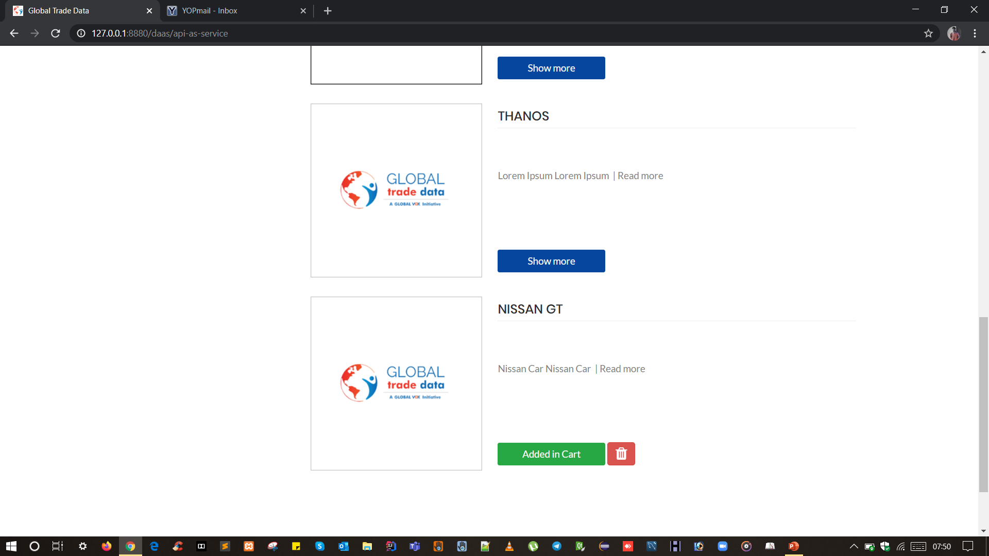

Slide 27
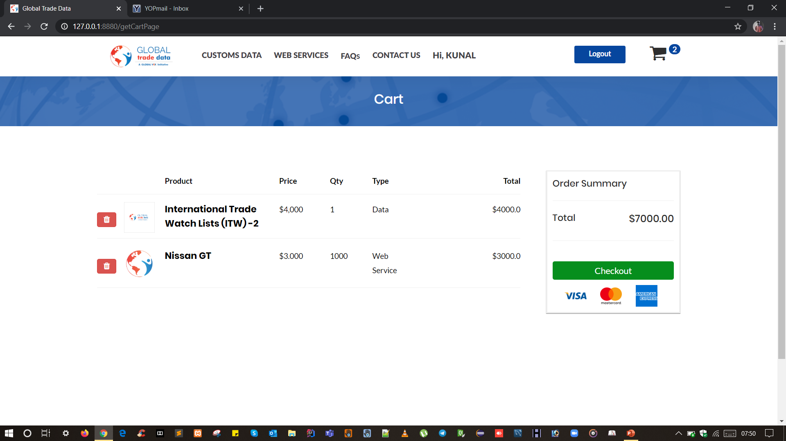

Slide 28
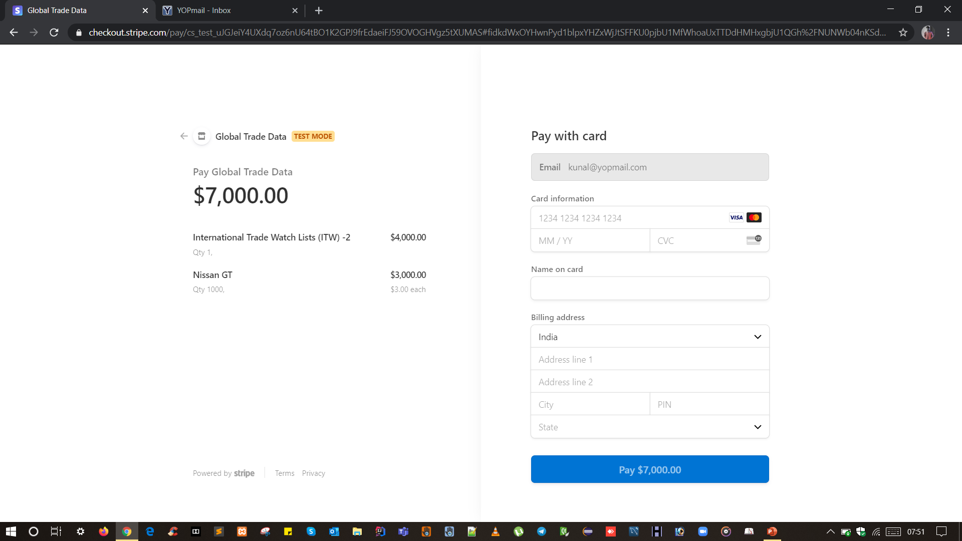

Slide 29
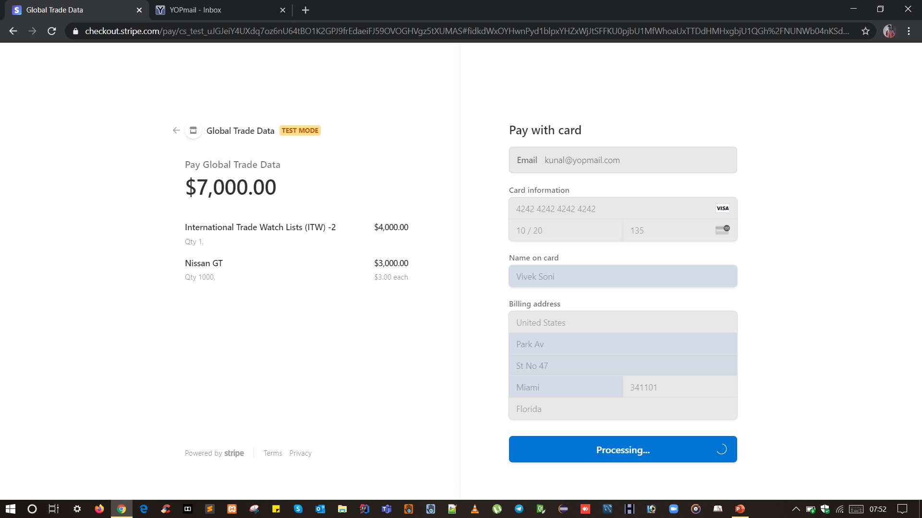

Slide 30
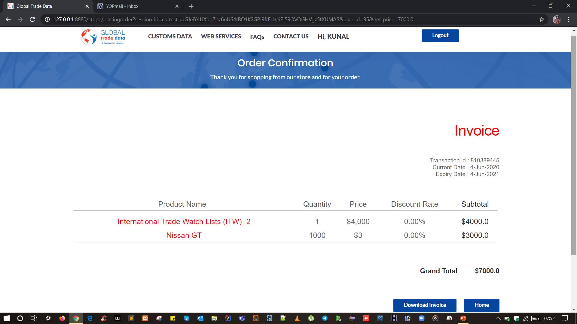

Slide 31
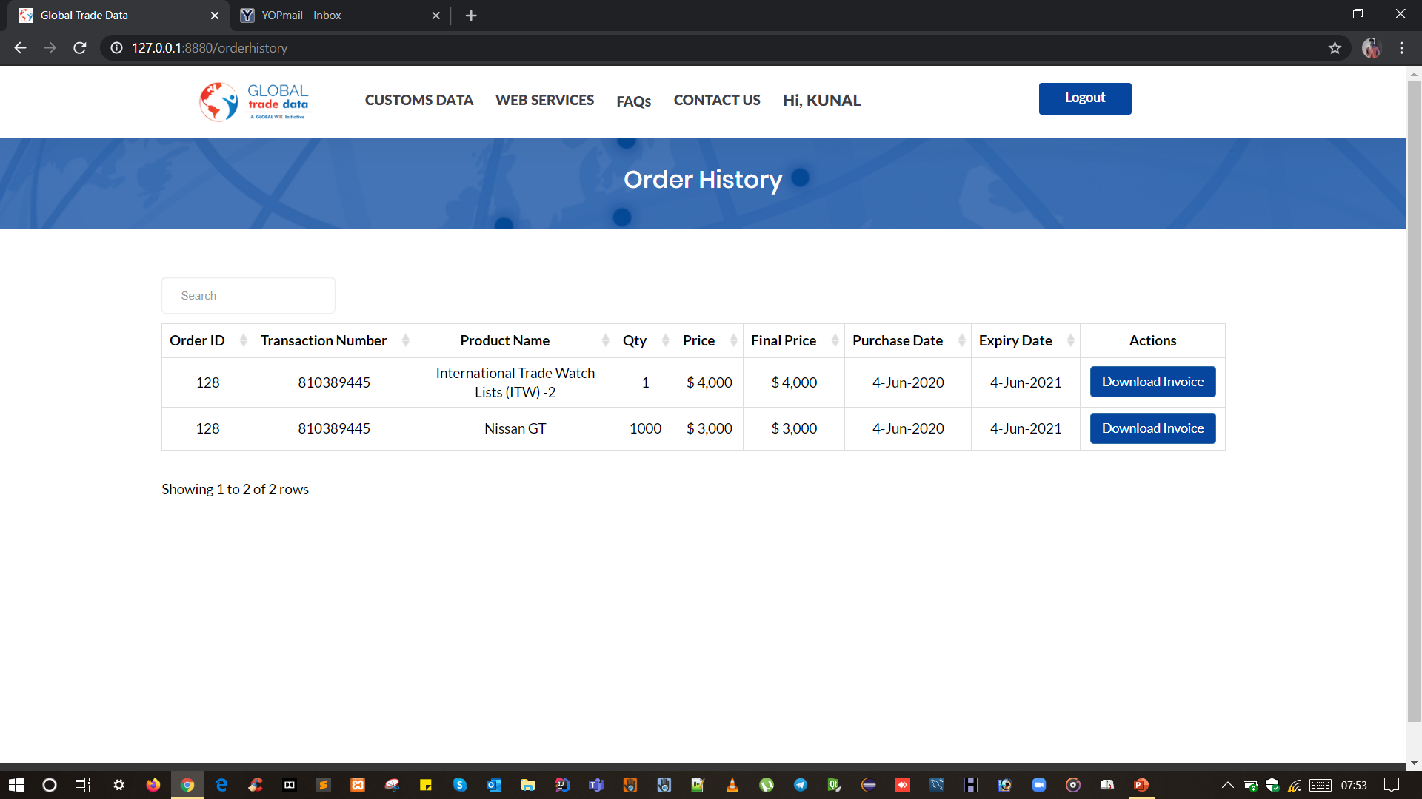

Slide 32
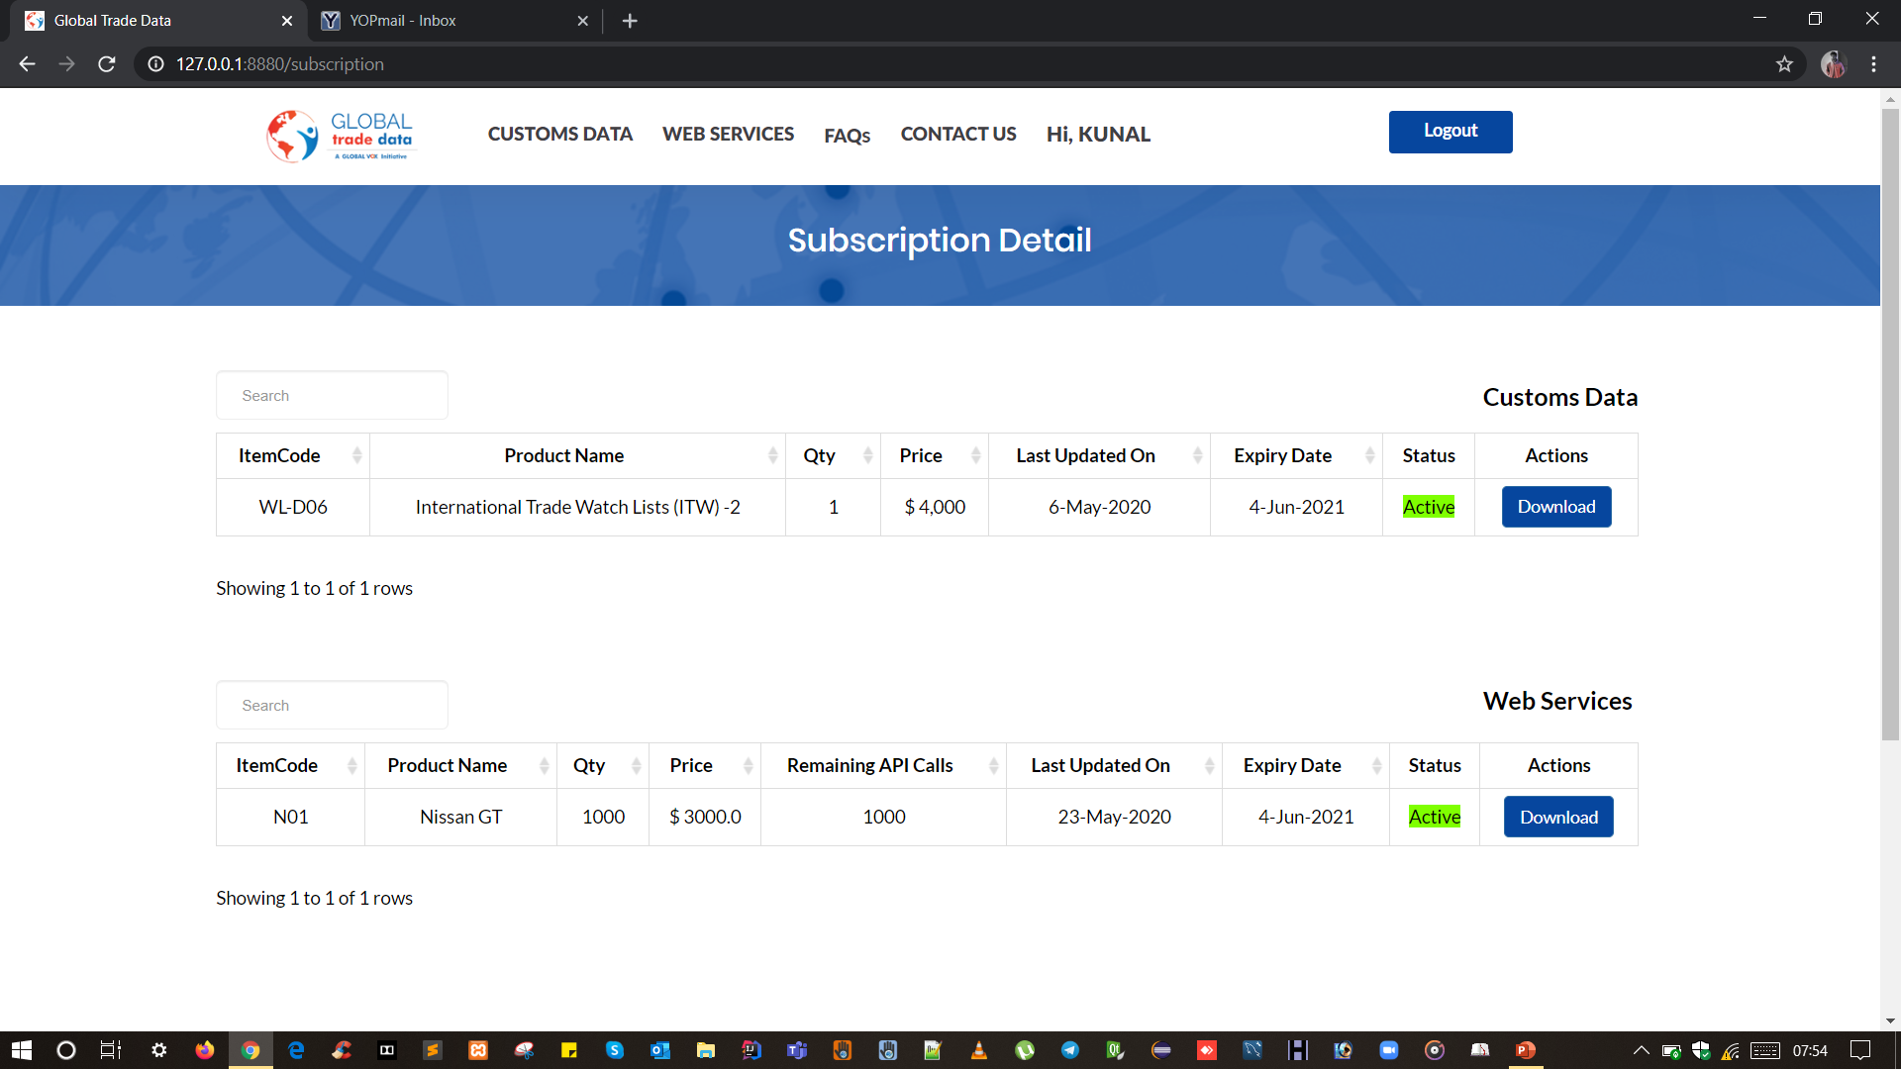

Slide 33
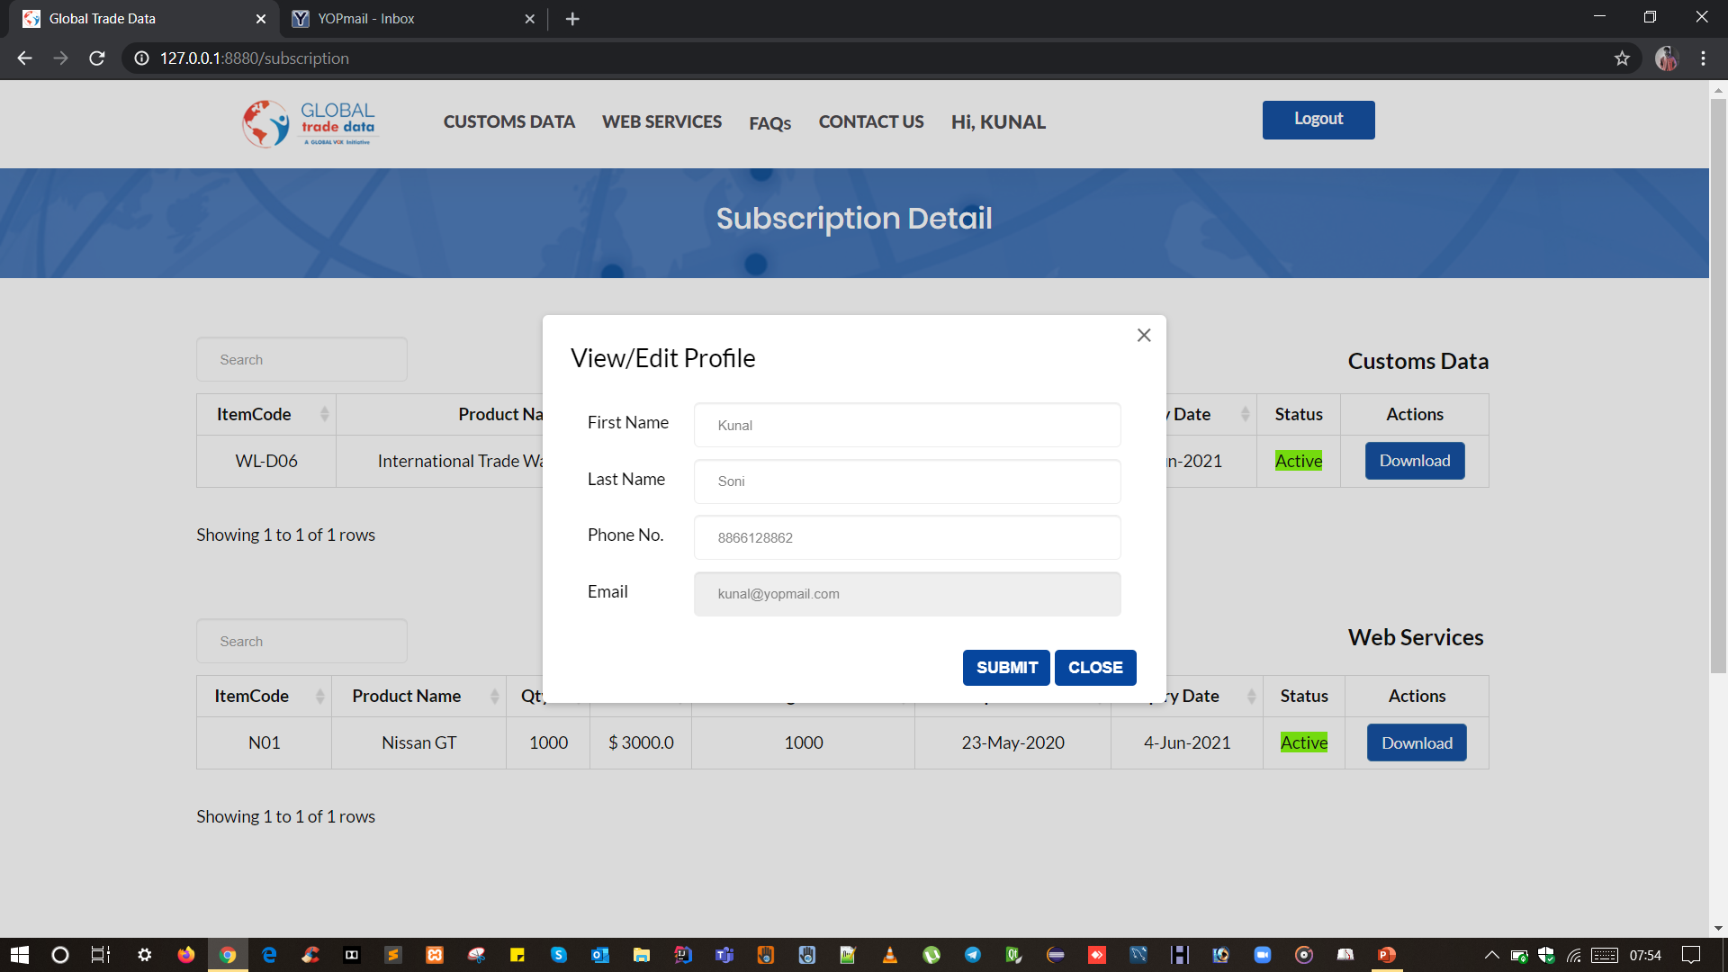

Slide 34
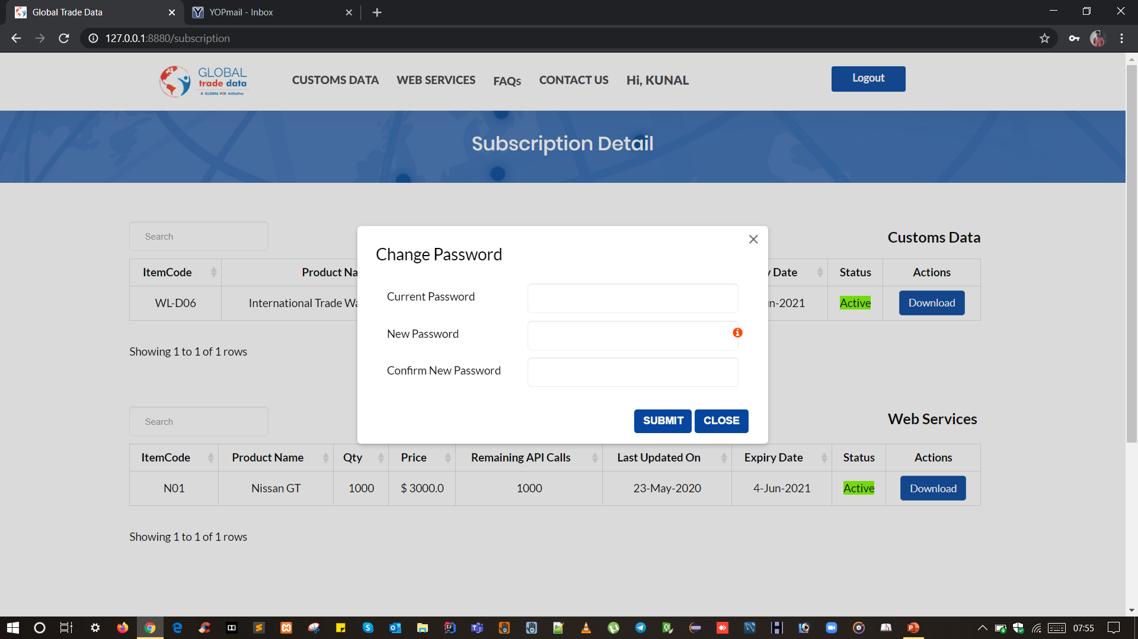

Slide 35
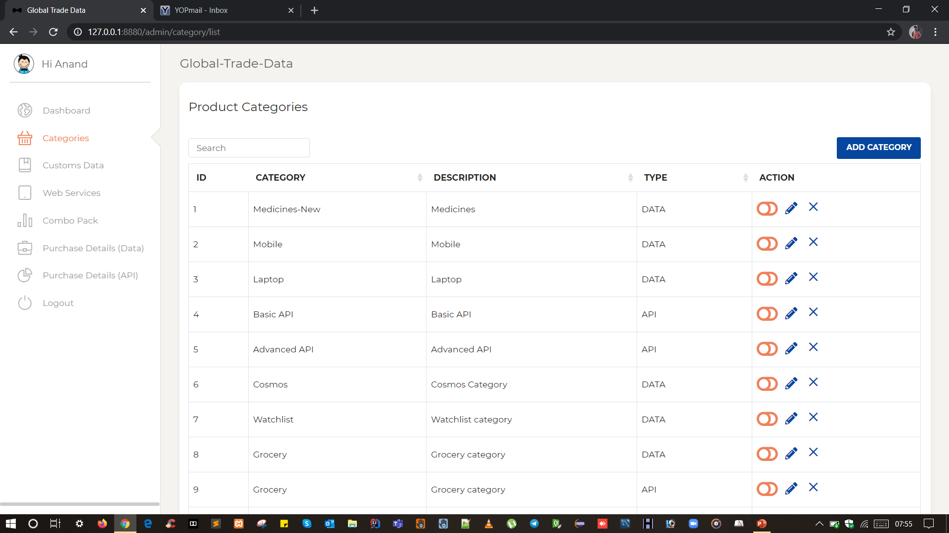

Slide 36
Road Ahead…
Will make this web app responsive for 720px and 360 px
Will add authentication layer on download feature from email
Penetration testing
Performance testing

Slide 37
THANKS!
ANY QUESTIONS?

